Slide 1

Engineering Case Studies (4)
Professor Bo Liu
James Watt School of Engineering

Slide 2
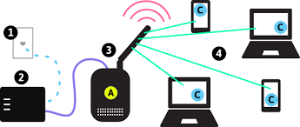
Network slicing
What is the network slicing?
In communication networks, resources (time, frequency, carrier and power) are allocated to different users.
Users have different requirements.
  Video call: medium-low latency (i.e., delay), high data rate
  Online game: low latency

Slide 3

Network slicing
Users with similar requirements form one network slice.
Sub-carriers allocate downlink power to users.
Sub-carriers
downlink
Slice 2
Slice 1

Slide 4
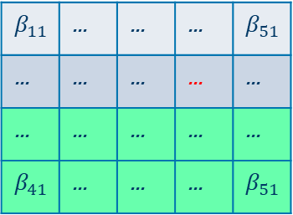
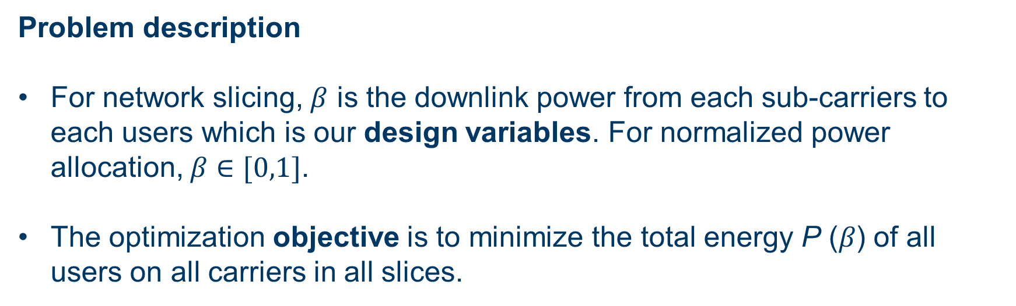
Network slicing
Problem description
For network slicing, $β$ is the downlink power from each sub-carriers to each users which is our design variables. For normalized power allocation, $β∈[0,1]$.
The optimization objective is to minimize the total energy P (𝛽) of all users on all carriers in all slices.
Sub-carriers
$$β_{11}$$ | ... | ... | ... | $$β_{51}$$
... | ... | ... | ... | ...
... | ... | ... | ... | ...
$$β_{41}$$ | ... | ... | ... | $$β_{51}$$
Slice 1
Slice 2

Slide 5
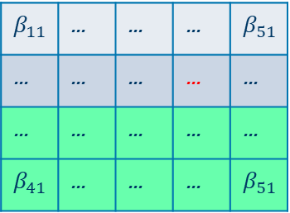
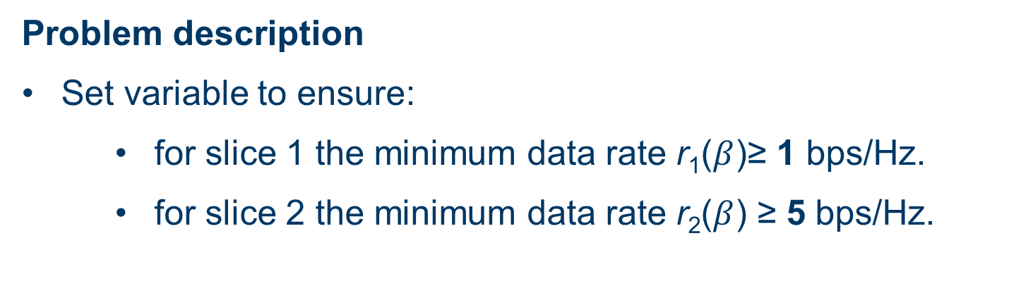
Network slicing
Problem description
Set variable to ensure:
for slice 1 the minimum data rate r₁($β$)≥ 1 bps/Hz.
for slice 2 the minimum data rate r₂($β$) ≥ 5 bps/Hz.
Sub-carriers
$$β_{11}$$ | ... | ... | ... | $$β_{51}$$
... | ... | ... | ... | ...
... | ... | ... | ... | ...
$$β_{41}$$ | ... | ... | ... | $$β_{51}$$
Slice 1
Slice 2

Slide 6
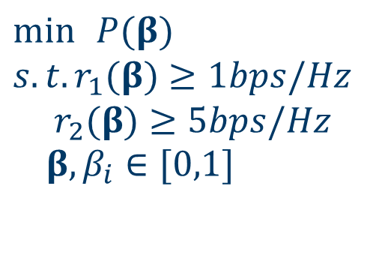
Network slicing
How to formulate the problem into an optimization problem?
Constrained optimization
$$\min{ }P(β) \\ s.t. r_{1}(β)≥1bps/Hz \\ r_{2}(β)≥5bps/Hz \\ β,β_{i}∈[0,1]$$
Objective function
Constraints
Design variables

Slide 7




Thanks!
#UofGWorldChangers
@UofGlasgow

